Slide 1

Computer Operating Systems BLG 312E Week-12 (Lecture-11)
Prof. Dr. Kemal Bıçakcı

Slide 2
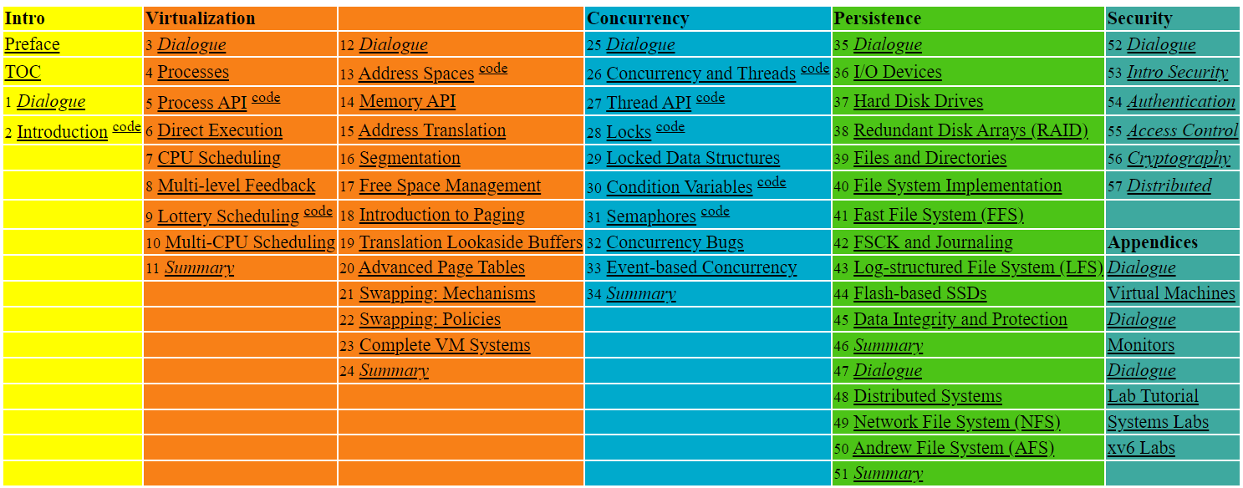

Slide 3
38. RAID
Operating System: Three Easy Pieces

Slide 4
RAID (Redundant Array of Inexpensive Disks)
Use multiple disks in concert to build a faster, bigger, and more reliable disk system.
RAID just looks like a big disk to the host system.
Advantage
Performance & Capacity: Using multiple disks in parallel
Reliability: RAID can tolerate the loss of a disk.
RAIDs provide these advantages transparently
to systems that use them.

Slide 5
RAID Interface
When a RAID receives I/O request,
The RAID calculates which disk to access.
The RAID issues one or more physical I/Os to do so.
RAID example: A mirrored RAID system
Keep two copies of each block (each one on a separate disk)
When writing, perform two physical I/Os for every one logical I/O it is issued.

Slide 6
RAID Internals
A microcontroller
Run firmware to direct the operation of the RAID
Volatile memory (such as DRAM)
Buffer data blocks
Non-volatile memory
Buffer writes safely
Specialized logic to perform parity calculation

Slide 7
Fault Model
RAIDs are designed to detect and recover from certain kinds of disk faults.
Fail-stop fault model
A disk can be in one of two states: Working or Failed.
Working: all blocks can be read or written.
Failed: the disk is permanently lost.
RAID controller can immediately observe when a disk has failed.

Slide 8
How to evaluate a RAID
Capacity
How much useful capacity is available to systems?
Reliability
How many disk faults can the given design tolerate?
Performance

Slide 9
RAID Level 0: Striping
RAID Level 0 is the simplest form as striping blocks.
Spread the blocks across the disks in a round-robin fashion.
No redundancy
Excellent performance and capacity
Disk 0 | Disk 1 | Disk 2 | Disk 3
0 | 1 | 2 | 3
4 | 5 | 6 | 7
8 | 9 | 10 | 11
12 | 13 | 14 | 15
Stripe
(The blocks in the same row)
RAID-0: Simple Striping
(Assume here a 4-disk array)

Slide 10
RAID Level 0 (Cont.)
Example: RAID-0 with a bigger chunk size
Chunk size : 2 blocks (8 KB)
A Stripe: 4 chunks (32 KB)
Disk 0 | Disk 1 | Disk 2 | Disk 3
0 | 2 | 4 | 6
1 | 3 | 5 | 7
8 | 10 | 12 | 14
9 | 11 | 13 | 15
chunk size:
2 blocks
Striping with a Bigger Chunk Size

Slide 11
Chunk Sizes
Chunk size mostly affects performance of the array
Small chunk size
Increasing the parallelism
Increasing positioning time to access blocks
Big chunk size
Reducing intra-file parallelism
Reducing positioning time
Determining the “best” chunk size is hard to do.
Most arrays use larger chunk sizes (e.g., 64 KB)

Slide 12

RAID Level 0 Analysis
Capacity → RAID-0 is perfect.
Striping delivers N disks worth of useful capacity.
Performance of striping → RAID-0 is excellent.
All disks are utilized often in parallel.
Reliability → RAID-0 is bad.
Any disk failure will lead to data loss.
$N$: the number of disks

Slide 13
Evaluating RAID Performance
Consider two performance metrics:
Single request latency
Steady-state throughput
Workload
Sequential: access MBs of data (e.g., block (B) to block (B + 10MB))
Random: access 4KB at random logical address
A disk can transfer data at
S MB/s under a sequential workload
R MB/s under a random workload

Slide 14
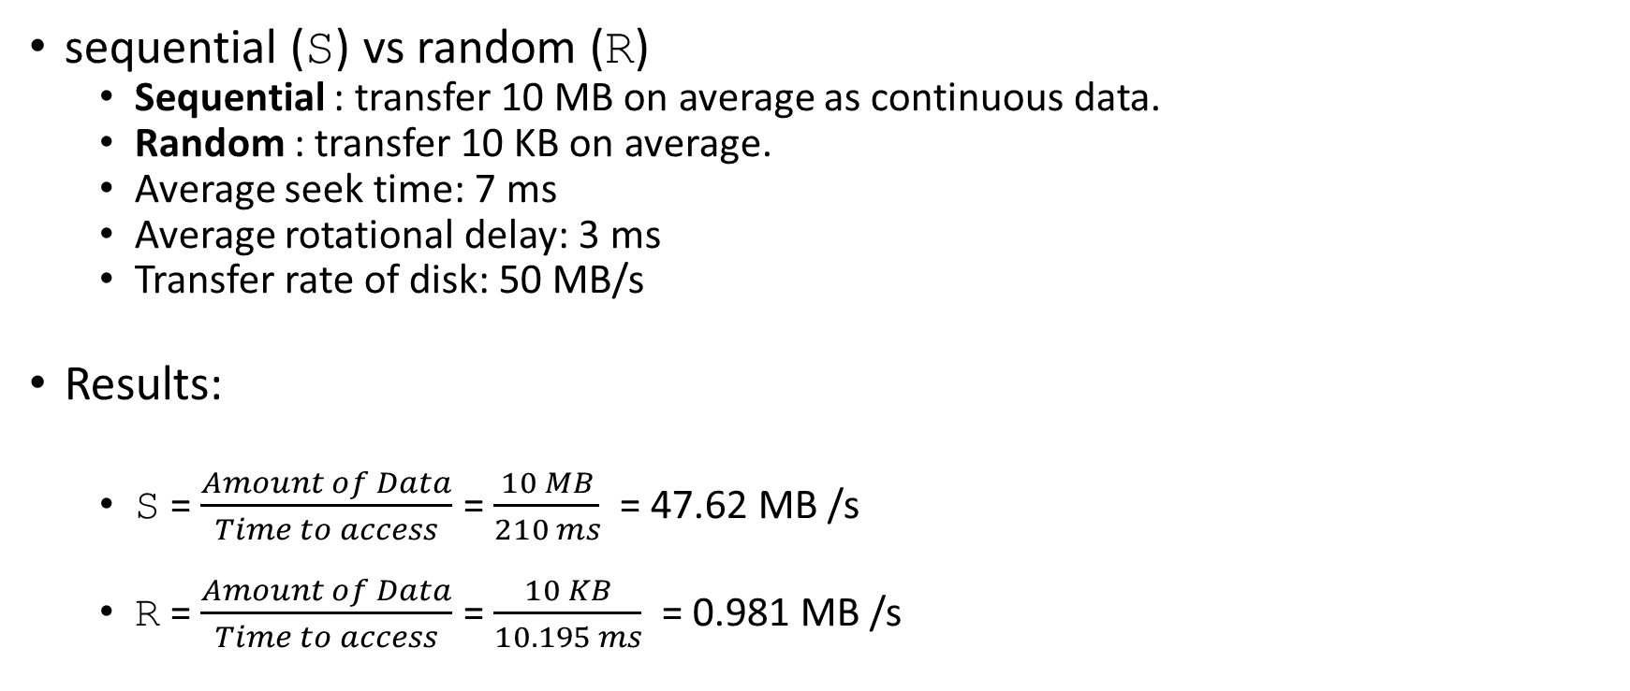
Evaluating RAID Performance Example
sequential (S) vs random (R)
Sequential : transfer 10 MB on average as continuous data.
Random : transfer 10 KB on average.
Average seek time: 7 ms
Average rotational delay: 3 ms
Transfer rate of disk: 50 MB/s
Results:
S = $\frac{Amount of Data}{Time to access}$ = $\frac{10 MB}{210 ms}$ = 47.62 MB /s
R = $\frac{Amount of Data}{Time to access}$ = $\frac{10 KB}{10.195 ms}$ = 0.981 MB /s

Slide 15


Evaluating RAID-0 Performance
Single request latency
Identical to that of a single disk.
Steady-state throughput
Sequential workload : $N∙S$ MB/s
Random workload : $N∙R$ MB/s
$N$: the number of disks

Slide 16
RAID Level 1 : Mirroring
RAID Level 1 tolerates disk failures.
Make more than one copy of each block in the system.
Each copy should be placed on a separate disk.
RAID-10 (RAID 1+0) : mirrored pairs and then stripe (the arrangement above)
RAID-01 (RAID 0+1) : contains two large striping (RAID-0) arrays, and then mirrors (RAID-1)
Disk 0 | Disk 1 | Disk 2 | Disk 3
0 | 0 | 1 | 1
2 | 2 | 3 | 3
4 | 4 | 5 | 5
6 | 6 | 7 | 7
Simple RAID-1: Mirroring (Keep two physical copies)

Slide 17

RAID-1 Analysis
Capacity: RAID-1 is Expensive
The useful capacity of RAID-1 is N/2.
Reliability: RAID-1 does well.
It can tolerate the failure of any one disk (up to N/2 failures depending on which disk fails).
$N$: the number of disks

Slide 18
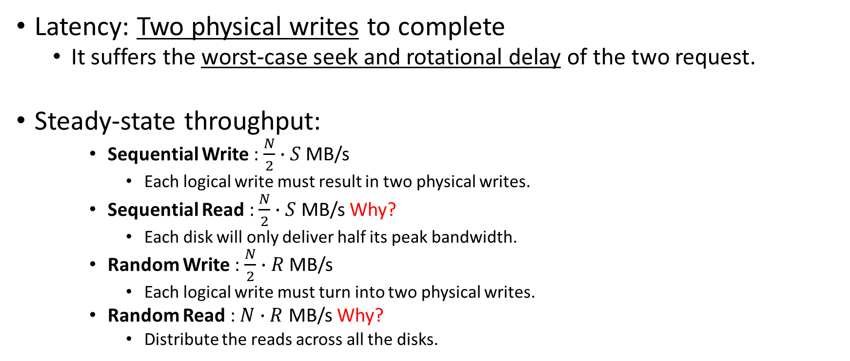
Performance of RAID-1
Latency: Two physical writes to complete
It suffers the worst-case seek and rotational delay of the two request.
Steady-state throughput:
Sequential Write : $\frac{N}{2}∙S$ MB/s
Each logical write must result in two physical writes.
Sequential Read : $\frac{N}{2}∙S$ MB/s Why?
Each disk will only deliver half its peak bandwidth.
Random Write : $\frac{N}{2}∙R$ MB/s
Each logical write must turn into two physical writes.
Random Read : $N∙R$ MB/s Why?
Distribute the reads across all the disks.

Slide 19
RAID Level 4 : Saving Space With Parity
Add a single parity block
A parity block stores the redundant information for that stripe of blocks.
* P: Parity
Disk 0 | Disk 1 | Disk 2 | Disk 3 | Disk 4
0 | 1 | 2 | 3 | P0
4 | 5 | 6 | 7 | P1
8 | 9 | 10 | 11 | P2
12 | 13 | 14 | 15 | P3
Five-disk RAID-4 system layout

Slide 20
RAID Level 4 (Cont.)
Compute parity : the XOR of all of bits
Recover from parity
Imagine the bit of the C2 in the first row is lost.
Reading the other values in that row : 0, 0, 1
The parity bit is 0 → even number of 1’s in the row
What the missing data must be: 1
C0 | C1 | C2 | C3 | P
0 | 0 | 1 | 1 | XOR(0,0,1,1)=0
0 | 1 | 0 | 0 | XOR(0,1,0,0)=1

Slide 21

RAID-4 Analysis
Capacity
The useful capacity is $\left(N−1\right)$.
Reliability
RAID-4 tolerates 1 disk failure and no more.
$N$: the number of disks

Slide 22

RAID-4 Analysis (Cont.)
Performance
Steady-state throughput
Sequential read: $\left(N−1\right)∙S$ MB/s
Sequential write: $\left(N−1\right)∙S$ MB/s
Random read: $\left(N−1\right)∙R$ MB/s
Disk 0 | Disk 1 | Disk 2 | Disk 3 | Disk 4
0 | 1 | 2 | 3 | P0
4 | 5 | 6 | 7 | P1
8 | 9 | 10 | 11 | P2
12 | 13 | 14 | 15 | P3
Full-stripe Writes In RAID-4

Slide 23
Random Write Performance for RAID-4
Overwrite a block + update the parity
Method 1: additive parity
Read in all of the other data blocks in the stripe
XOR those blocks with the new block (1)
Problem: the performance scales with the number of disks

Slide 24
Random Write Performance for RAID-4 (Cont.)
Method 2: subtractive parity
Update C2(old) → C2(new)
Read in the old data at C2 (C2(old)=1) and the old parity (P(old)=0)
Calculate P(new):
If C2(new)==C2(old) → P(new)==P(old)
If C2(new)!=C2(old) → Flip the old parity bit
C0 | C1 | C2 | C3 | P
0 | 0 | 1 | 1 | XOR(0,0,1,1)=0
$$P\left(new\right)=\left(C2\left(old\right) XOR C2\left(new\right)\right) XOR P(old)$$

Slide 25
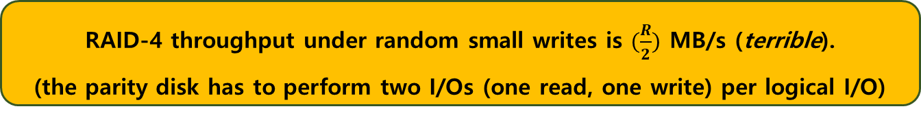
Small-write problem
The parity disk can be a bottleneck.
Example: update blocks 4 and 13 (marked with *)
Disk 0 and Disk 1 can be accessed in parallel.
Disk 4 prevents any parallelism.
Disk 0 | Disk 1 | Disk 2 | Disk 3 | Disk 4
0 | 1 | 2 | 3 | P0
*4 | 5 | 6 | 7 | +P1
8 | 9 | 10 | 11 | P2
12 | *13 | 14 | 15 | +P3
Writes To 4, 13 And Respective Parity Blocks.
RAID-4 throughput under random small writes is $(\frac{R}{2})$ MB/s (terrible).
(the parity disk has to perform two I/Os (one read, one write) per logical I/O)

Slide 26
I/O Latency in RAID-4
A single read
Equivalent to the latency of a single disk request.
A single write
Two reads and then two writes
Data block + Parity block
The reads can happen in parallel and writes can happen in parallel.
Total latency is about twice that of a single disk.

Slide 27
RAID Level 5: Rotating Parity
RAID-5 is a solution of small write problem.
Rotate the parity blocks across drives.
Remove the parity-disk bottleneck for RAID-4
Disk 0 | Disk 1 | Disk 2 | Disk 3 | Disk 4
0 | 1 | 2 | 3 | P0
5 | 6 | 7 | P1 | 4
10 | 11 | P2 | 8 | 9
15 | P3 | 12 | 13 | 14
P4 | 16 | 17 | 18 | 19
RAID-5 With Rotated Parity

Slide 28

RAID-5 Analysis
Capacity
The useful capacity for a RAID group is $\left(N−1\right)$.
Reliability
RAID-5 tolerates 1 disk failure and no more.
$N$: the number of disks

Slide 29

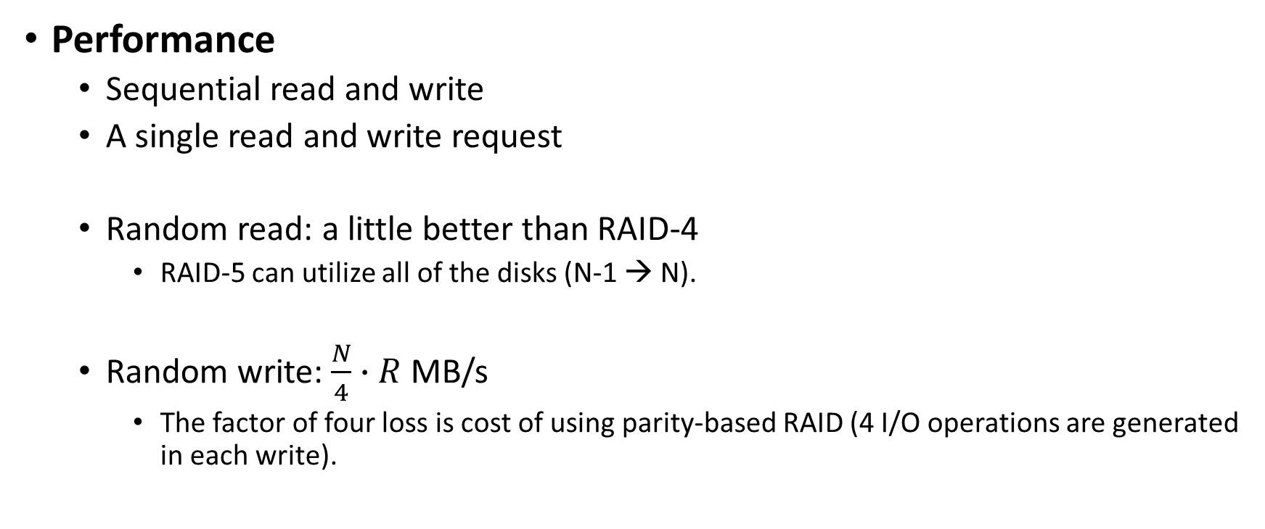
RAID-5 Analysis (Cont.)
Performance
Sequential read and write
A single read and write request
Random read: a little better than RAID-4
RAID-5 can utilize all of the disks (N-1 → N).
Random write: $\frac{N}{4}∙R$ MB/s
The factor of four loss is cost of using parity-based RAID (4 I/O operations are generated in each write).
Same as RAID-4
$N$: the number of disks

Slide 30
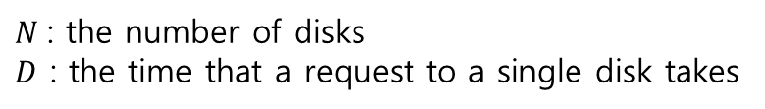
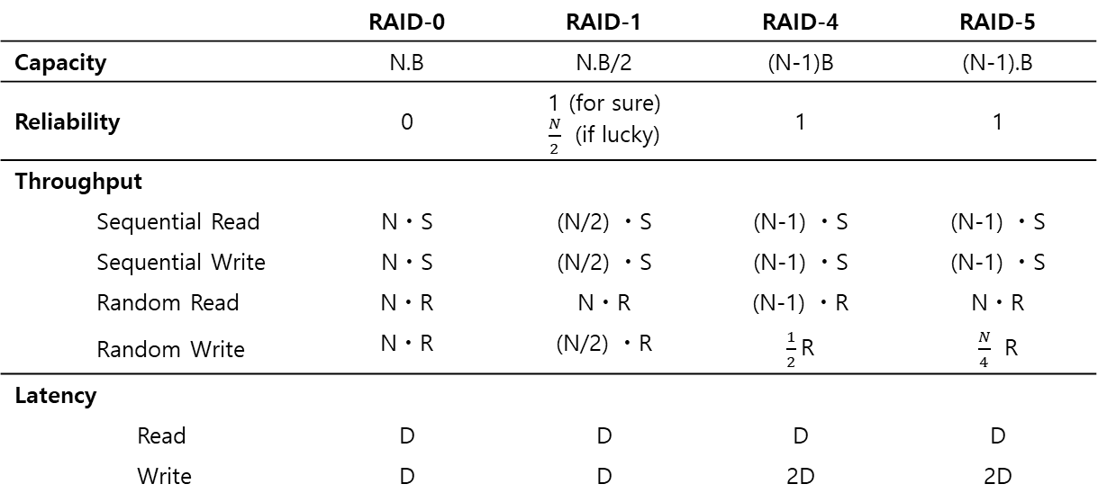
RAID Comparison: A Summary
$N$: the number of disks
$D$ : the time that a request to a single disk takes
 |  |  | RAID-0 | RAID-1 | RAID-4 | RAID-5
Capacity |  |  | N.B | N.B/2 | (N-1)B | (N-1).B
Reliability |  |  | 0 | 1 (for sure) $\frac{N}{2}$ (if lucky) | 1 | 1
Throughput
 | Sequential Read |  | NㆍS | (N/2) ㆍS | (N-1) ㆍS | (N-1) ㆍS
 | Sequential Write |  | NㆍS | (N/2) ㆍS | (N-1) ㆍS | (N-1) ㆍS
 | Random Read |  | NㆍR | NㆍR | (N-1) ㆍR | NㆍR
 | Random Write |  | NㆍR | (N/2) ㆍR | $\frac{1}{2}$R | $\frac{N}{4}$ R
Latency
 |  | Read | D | D | D | D
 |  | Write | D | D | 2D | 2D
RAID Capacity, Reliability, and Performance

Slide 31
RAID Comparison: A Summary
Performance and do not care about reliability → RAID-0 (Striping)
Random I/O performance and Reliability → RAID-1 (Mirroring)
Capacity and Reliability → RAID-5
Sequential I/O and Maximize Capacity → RAID-5

Slide 32
39. File and Directories
Operating System: Three Easy Pieces

Slide 33
Persistent Storage
Keep a data intact even if there is a power loss.
Hard disk drive
Solid-state storage device
Two key abstractions in the virtualization of storage
File
Directory

Slide 34
File
A linear array of bytes
Each file has low-level name as inode number
The user is not aware of this name.
File system has a responsibility to store data persistently on disk.

Slide 35
Directory
Directory is like a file, also has a low-level name.
It contains a list of (user-readable name, low-level name) pairs.
Each entry in a directory refers to either files or other directories.
Example:
A directory has an entry (“foo”, “10”)
A file “foo” with the low-level name “10”

Slide 36
Directory Tree (Directory Hierarchy)
/
root directory
Valid files (absolute pathname):
/foo/bar.txt
/bar/foo/bar.txt
Valid directory:
/
/foo
/bar
/bar/bar
/bar/foo/
foo
bar
bar.txt
bar
foo
Sub-directories
bar.txt
An Example Directory Tree

Slide 37
Creating Files
Use open() system call with O_CREAT flag.
O_CREAT : create file.
O_WRONLY : only write to that file while opened.
O_TRUNC : make the file size zero (remove any existing content).
open() system call returns a file descriptor.
File descriptor is an integer, and is used to access files.
int fd = open(“foo”, O_CREAT | O_WRONLY | O_TRUNC);

Slide 38

Question (to Ken Thompson – Unix co-father): What would you do differently if you were redesigning Unix? Answer: I’d spell creat with an e.

Slide 39
Reading and Writing Files
An Example of reading and writing ‘foo’ file
echo: redirect the output of echo to the file foo
cat: dump the contents of a file to the screen
prompt> echo hello > foo
prompt> cat foo
hello
prompt>
How does the cat program access the file foo ?
We can use strace to trace the system calls made by a program.

Slide 40
Reading and Writing Files (Cont.)
prompt> strace cat foo
…
open(“foo”, O_RDONLY|O_LARGEFILE) = 3
read(3, “hello\n”, 4096) = 6
write(1, “hello\n”, 6) = 6 // file descriptor 1: standard out
hello
read(3, “”, 4096) = 0 // 0: no bytes left in the file
close(3) = 0
…
prompt>
open(file descriptor, flags)
Return file descriptor (3 in example)
File descriptors 0, 1, 2 are for standard input/ output/ error.
read(file descriptor, buffer pointer, the size of the buffer)
Return the number of bytes it reads
write(file descriptor, buffer pointer, the size of the buffer)
Return the number of bytes it writes

Slide 41
Reading and Writing Files (Cont.)
Writing a file (A similar set of steps as in Read)
A file is opened for writing (open()).
The write()system call is called.
Repeatedly called for larger files
close()

Slide 42
Reading And Writing, But Not Sequentially
An open file has a current offset.
Determine where the next read or write will begin reading from or writing to within the file.
Update the current offset
Implicitly: A read or write of N bytes takes place, N is added to the current offset.
Explicitly: lseek()

Slide 43
Reading And Writing, But Not Sequentially (Cont.)
off_t lseek(int fildes, off_t offset, int whence);
fildes: File descriptor
offset: Position the file offset to a particular location within the file
whence: Determine how the seek is performed
From the man page:
If whence is SEEK_SET, the offset is set to offset bytes.
If whence is SEEK_CUR, the offset is set to its current location plus offset bytes.
If whence is SEEK_END, the offset is set to the size of the file plus offset bytes.

Slide 44
Writing Immediately with fsync()
The file system will buffer writes in memory for some time.
Example: for 5 seconds, or 30
Performance reasons
At that later point in time, the write(s) will actually be issued to the storage device.
Write seems to be completed quickly.
Data can be lost (e.g., the machine crashes).

Slide 45
Writing Immediately with fsync() (Cont.)
However, some applications require more than eventual guarantee.
Example: DBMS requires force writes to disk from time to time.
off_t fsync(int fd)
Filesystem forces all dirty (i.e., not yet written) data to disk for the file referred to by the file descriptor.
fsync() returns once all of these writes are completed.

Slide 46
Writing Immediately with fsync() (Cont.)
An Example for fsync():
In some cases, the directory that contains the file foo also needs fsync().
int fd = open("foo", O_CREAT | O_WRONLY | O_TRUNC);
assert (fd > -1)
int rc = write(fd, buffer, size);
assert (rc == size);
rc = fsync(fd);
assert (rc == 0);

Slide 47
Renaming Files
rename(char* old, char *new)
Rename a file to different name.
It is implemented as an atomic call.
Example: Change from foo to bar:
Example: How to update a file atomically using a file editor like emacs:
prompt> mv foo bar // mv uses the system call rename()
int fint fd = open("foo.txt.tmp", O_WRONLY|O_CREAT|O_TRUNC);
write(fd, buffer, size); // write out new version of file
fsync(fd);
close(fd);
rename("foo.txt.tmp", "foo.txt");

Slide 48
Getting Information About Files
stat(),fstat(): System calls showing the file metadata
Metadata is information about each file.
Example: Size, Low-level name, Permission, …
stat structure:
struct stat {
dev_t st_dev; /* ID of device containing file */
ino_t st_ino; /* inode number */
mode_t st_mode; /* protection */
nlink_t st_nlink; /* number of hard links */
uid_t st_uid; /* user ID of owner */
gid_t st_gid; /* group ID of owner */
dev_t st_rdev; /* device ID (if special file) */
off_t st_size; /* total size, in bytes */
blksize_t st_blksize; /* blocksize for filesystem I/O */
blkcnt_t st_blocks; /* number of blocks allocated */
time_t st_atime; /* time of last access */
time_t st_mtime; /* time of last modification */
time_t st_ctime; /* time of last status change */
};

Slide 49
Getting Information About Files (Cont.)
To see stat information, you can use the command line tool stat.
File system keeps this type of information in an inode structure.
prompt> echo hello > file
prompt> stat file
File: ‘file’
Size: 6 Blocks: 8 IO Block: 4096 regular file
Device: 811h/2065d Inode: 67158084 Links: 1
Access: (0640/-rw-r-----) Uid: (30686/ root) Gid: (30686/ remzi)
Access: 2011-05-03 15:50:20.157594748 -0500
Modify: 2011-05-03 15:50:20.157594748 -0500
Change: 2011-05-03 15:50:20.157594748 -0500

Slide 50
Removing Files
rm is Linux command to remove a file
rm call unlink() to remove a file.
prompt> strace rm foo
…
unlink(“foo”) = 0 // return 0 upon success
…
prompt>
Why it calls unlink() not “remove or delete” ?

Slide 51
Making Directories
mkdir(): Make a directory
When a directory is created, it is empty.
Empty directory has two entries: . (itself), .. (parent)
prompt> strace mkdir foo
…
mkdir(“foo”, 0777) = 0
prompt>
prompt> ls –a
./ ../
prompt> ls -al
total 8
drwxr-x--- 2 remzi remzi 6 Apr 30 16:17 ./
drwxr-x--- 26 remzi remzi 4096 Apr 30 16:17 ../

Slide 52
Reading Directories
A sample code to read directory entries (like ls).
The information available within struct dirent
int main(int argc, char *argv[]) {
DIR *dp = opendir("."); // open current directory
assert(dp != NULL);
struct dirent *d;
while ((d = readdir(dp)) != NULL) // read one directory entry
{
// print out the name and inode number of each file
printf("%d %s\n", (int) d->d_ino, d->d_name);
}
closedir(dp); // close current directory
return 0;
}
struct dirent {
char d_name[256]; /* filename */
ino_t d_ino; /* inode number */
off_t d_off; /* offset to the next dirent */
unsigned short d_reclen; /* length of this record */
unsigned char d_type; /* type of file */
}

Slide 53
Deleting Directories
rmdir(): Delete a directory.
Require that the directory be empty.
If you call rmdir()to a non-empty directory, it will fail.
i.e., only has “.” and “..” entries.

Slide 54
Hard Links
link(old pathname, new one)
Link a new file name to an old one
Create another way to refer to the same file
The command-line link program : ln
prompt> echo hello > file
prompt> cat file
hello
prompt> ln file file2 // create a hard link, link file to file2
prompt> cat file2
hello

Slide 55
Hard Links (Cont.)
The way link works:
Create another name in the directory.
Refer it to the same inode number of the original file.
The file is not copied in any way.
Then, we now just have two human names (file and file2) that both refers to the same file.

Slide 56
Hard Links (Cont.)
The result of link()
Two files have the same inode number, but two human names (file, file2).
There is no difference between file and file2.
Both just links to the same underlying metadata about the file.
prompt> ls -i file file2
67158084 file /* inode value is 67158084 */
67158084 file2 /* inode value is 67158084 */
prompt>

Slide 57
Hard Links (Cont.)
Thus, to remove a file, we call unlink().
reference count
Track how many different file names have been linked to this inode.
When unlink() is called, the reference count decrements.
If the reference count reaches zero, the filesystem frees the inode and related data blocks. → truly “delete” the file
truly ???
prompt> rm file
removed ‘file’
prompt> cat file2 // Still access the file
hello

Slide 58
Hard Links (Cont.)
The result of unlink()
stat() shows the reference count of a file.
prompt> echo hello > file /* create file*/
prompt> stat file
... Inode: 67158084 Links: 1 ... /* Link count is 1 */
prompt> ln file file2 /* hard link file2 */
prompt> stat file
... Inode: 67158084 Links: 2 ... /* Link count is 2 */
prompt> stat file2
... Inode: 67158084 Links: 2 ... /* Link count is 2 */
prompt> ln file2 file3 /* hard link file3 */
prompt> stat file
... Inode: 67158084 Links: 3 ... /* Link count is 3 */
prompt> rm file /* remove file */
prompt> stat file2
... Inode: 67158084 Links: 2 ... /* Link count is 2 */
prompt> rm file2 /* remove file2 */
prompt> stat file3
... Inode: 67158084 Links: 1 ... /* Link count is 1 */
prompt> rm file3

Slide 59
Symbolic Links (Soft Link)
Symbolic link is sometimes more useful than Hard link.
Hard Link cannot be created to a directory.
Hard Link cannot be created to a file in another disk partition.
Because inode numbers are only unique within a file system.
Create a symbolic link: ln -s
prompt> echo hello > file
prompt> ln –s file file2 /* option –s: create a symbolic link, */
prompt> cat file2
hello

Slide 60
Symbolic Links (Cont.)
What is different between Symbolic link and Hard Link?
Symbolic links are a third type the file system knows about.
The size of symbolic link (file2) is 4 bytes.
A symbolic link holds the pathname of the linked-to file as the data of the link file.
prompt> stat file
... regular file ...
prompt> stat file2
... symbolic link ... // Actually a file it self of a different type
prompt> ls -al
drwxr-x--- 2 remzi remzi 29 May 3 19:10 ./
drwxr-x--- 27 remzi remzi 4096 May 3 15:14 ../ // directory
-rw-r----- 1 remzi remzi 6 May 3 19:10 file // regular file
lrwxrwxrwx 1 remzi remzi 4 May 3 19:10 file2 -> file // symbolic link

Slide 61
Symbolic Links (Cont.)
If we link to a longer pathname, our link file would be bigger.
prompt> echo hello > alongerfilename
prompt> ln -s alongerfilename file3
prompt> ls -al alongerfilename file3
-rw-r----- 1 remzi remzi 6 May 3 19:17 alongerfilename
lrwxrwxrwx 1 remzi remzi 15 May 3 19:17 file3 -> alongerfilename

Slide 62
Symbolic Links (Cont.)
Dangling reference
When we remove the original file, symbolic link points nothing.
prompt> echo hello > file
prompt> ln -s file file2
prompt> cat file2
hello
prompt> rm file // remove the original file
prompt> cat file2
cat: file2: No such file or directory

Slide 63
Making and Mounting a File System
mkfs tool : Make a file system
Write an empty file system, starting with a root directory, on to a disk partition.
Input:
A device (such as a disk partition, e.g., /dev/sda1)
A file system type (e.g., ext3)

Slide 64
Making and Mounting a File System (Cont.)
mount()
Takes an existing directory as a target mount point.
Essentially paste a new file system onto the directory tree at that point.
Example:
The pathname /home/users/ now refers to the root of the newly-mounted directory.
prompt> mount –t ext3 /dev/sda1 /home/users
prompt> ls /home/users
a b

Slide 65
Making and Mounting a File System (Cont.)
mount program: show what is mounted on a system.
ext3: A standard disk-based file system
proc: A file system for accessing information about current processes
tmpfs: A file system just for temporary files
AFS: A distributed file system
/dev/sda1 on / type ext3 (rw)
proc on /proc type proc (rw)
sysfs on /sys type sysfs (rw)
/dev/sda5 on /tmp type ext3 (rw)
/dev/sda7 on /var/vice/cache type ext3 (rw)
tmpfs on /dev/shm type tmpfs (rw)
AFS on /afs type afs (rw)

